Slide 1

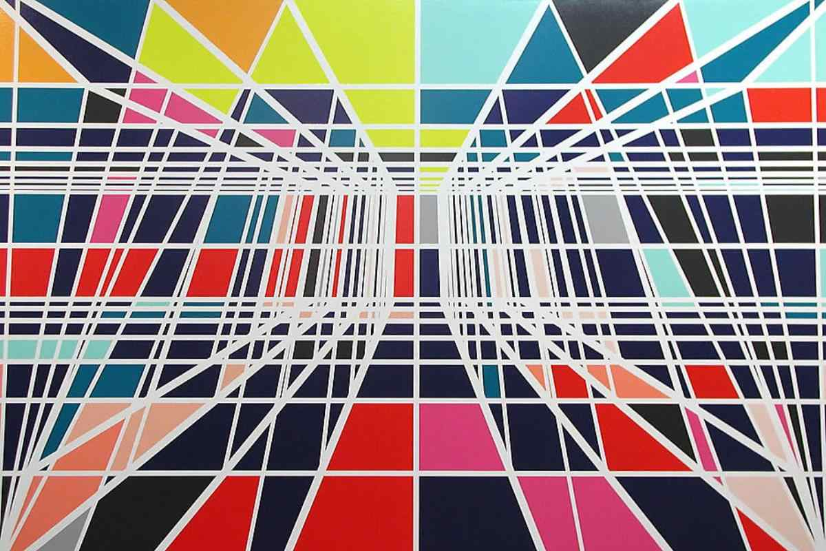

System Analysis and Design
Use Case Diagrams Tutorial

Slide 2
What is a use case?
A requirements analysis concept.
A case of a use of the system/product.
Describes the system's actions from the point of view of a user.
Specifies one aspect of the behaviour of a system, without specifying the structure of the system
Is oriented toward satisfying a user's goal.

Slide 3

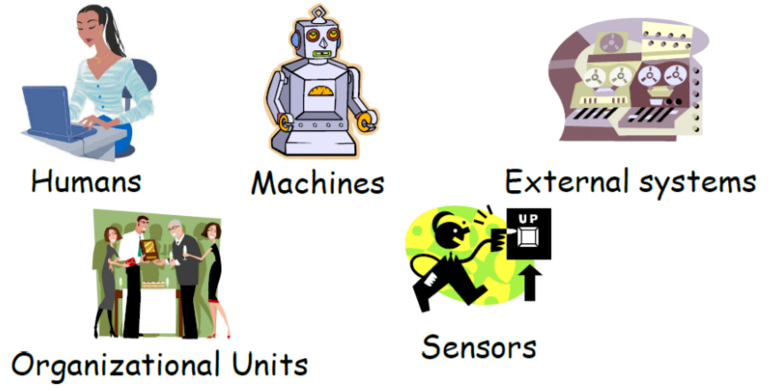
Elements of use case diagrams
Actor
External objects that produce/consume data
Must serve as sources and destinations for data
Must be external to the system

Slide 4
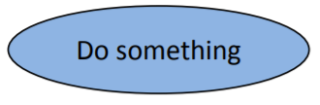
Elements of use case diagrams
Use case
System function (process – automated or manual)
Named by verb.
Each Actor must be linked to a use case, while some use cases may not be linked to actors.

Slide 5
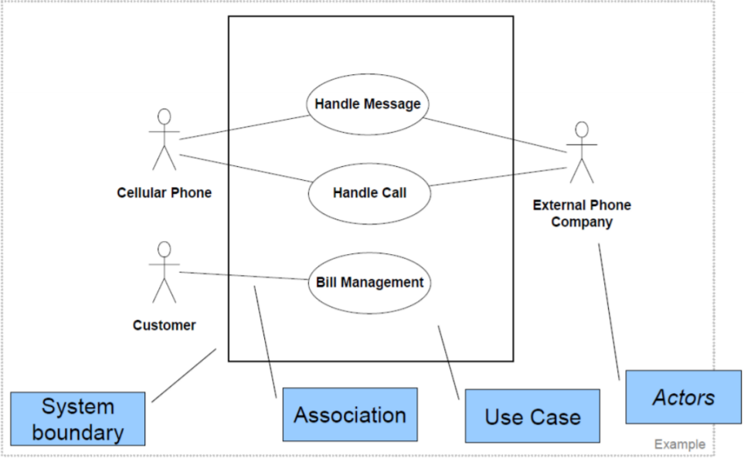
Elements of use case diagrams
Association relationship
System boundary

Slide 6
Elements of use case diagrams
<<include>>
Include relationship
One UC must call another; e.g., Login UC includes User Authentication UC
One use case (base) includes the functionality of another (inclusion case)
Extend relationship
One UC calls another under certain condition; think of if-then decision points
One use case (extension) extends the behaviour of another (base)
Generalization relationship
One element (child) "is based on" another element (parent)
<<extend>>

Slide 7
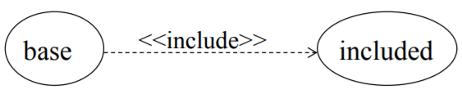
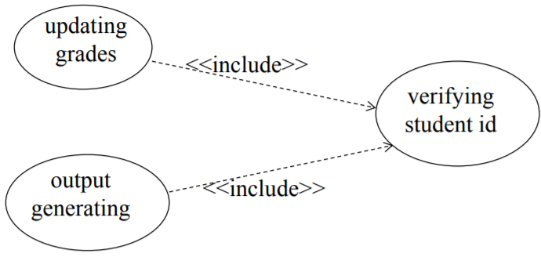
Elements of use case diagrams
Include relationship
The included use case never stands alone. It only occurs as a part of some larger base that includes it.
Base use case can NOT execute without the include case (tight coupling).

Slide 8
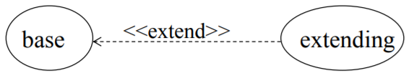
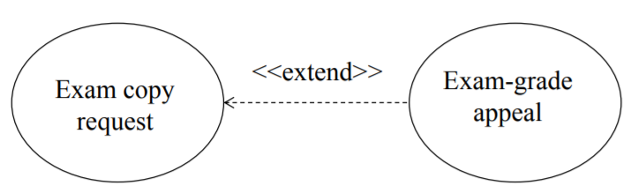
Elements of use case diagrams
Extend relationship
The base use case may stand alone, but under certain conditions its behaviour may be extended by the behaviour of another use case.
Enables to model optional behaviour or branching under conditions.
Base use case can execute without the extend case (loose coupling).

Slide 9
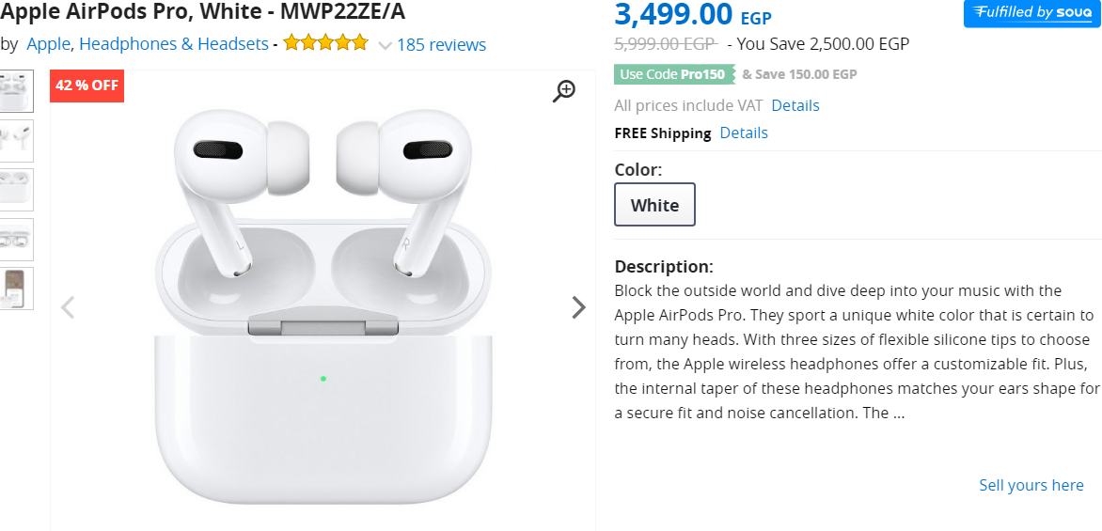

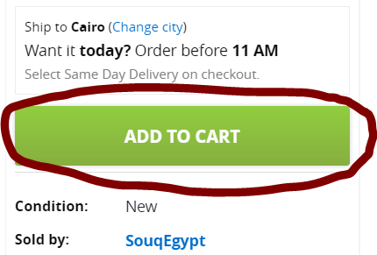
Elements of use case diagrams
Extend vs Include
<<extend>>
<<extend>>

Slide 10
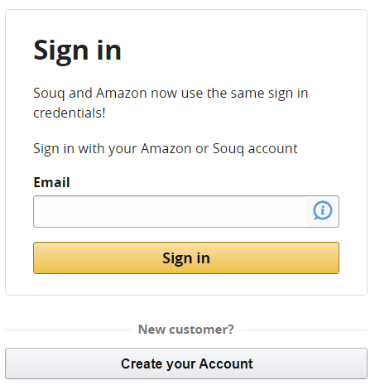
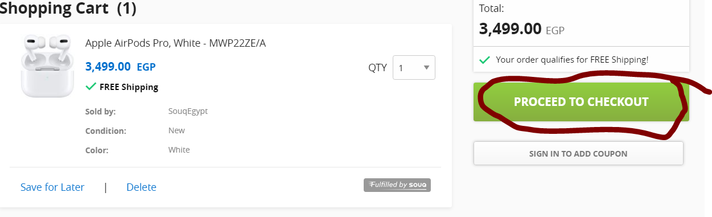
Elements of use case diagrams
Extend vs Include
<<include>>

Slide 11
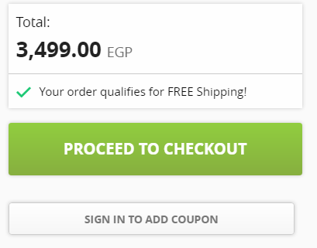
Elements of use case diagrams
Generalization
Purchase
Coupon Purchase

Slide 12
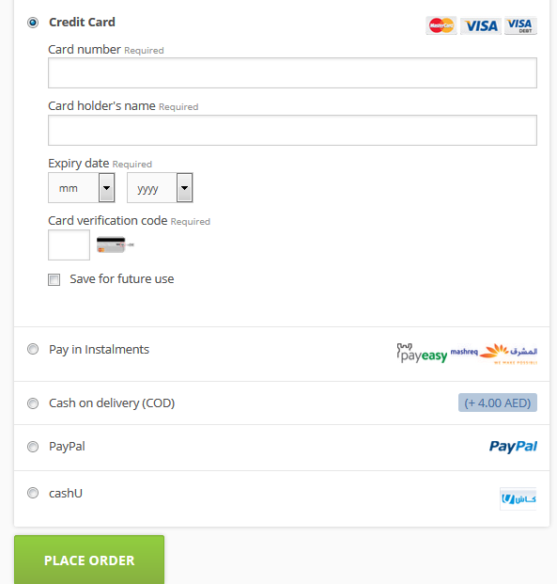
Elements of use case diagrams
Generalization
Pay
Visa Pay
Cash on delivery
Master card Pay

Slide 13
How to create use case diagram
List main system functions (use cases) in a column:
Think of business events demanding system’s response
Users’ goals/needs to be accomplished via the system
Create, Read, Update, Delete (CRUD) data tasks
Naming use cases – user’s needs usually can be translated in data tasks
Draw actors and connect them with use cases
Draw system boundary
Specify include and extend relationships between use cases

Slide 14
Exercise
Mr. Adel is an Egyptian businessman wants to invest a portion of his wealth in a profitable chat application. The application system is maintained by a system administrator who can add or delete ads, test for system bugs and maintain system’s security. The system will interact with two kinds of users: a normal user and a premium user. Both users are required to register in the system. The normal user can send/receive text messages, audio files and images and add new contacts. The premium user can do the same things that a normal user do, in addition to he/she can send videos and will not has ads. Premium users must pay a subscription. The system uses a server to store the database and the ads.
Identify actors and use cases

Slide 15
My Proposed Solution
Actor | Actions (use cases)
System Administrator | Add/delete ads, test system bugs, check security
User | Send/receive(messages, audio, images), add/delete contacts, register, purchase premium membership
Premium user | Send/receive(messages, audio, images), send/receive videos, add/delete contacts, register
Server | Store database, show ads, hide ads

Slide 16
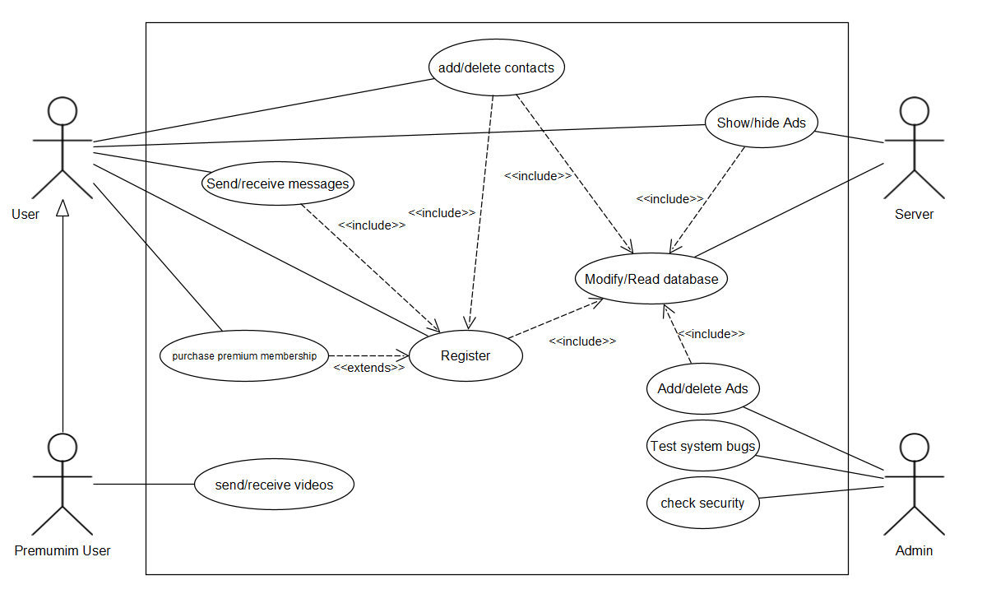
My Proposed Solution

Slide 17
Use Case Scenario
A textual description that captures the full information of the actual use cases.
Use Case | Use case name or identifier
Description | Goal to be achieved and sources of requirements (include and extend relations)
Assumptions | Conditions the must be true for the use case to terminate successfully
Steps | Steps followed by actors and other system uses cases to achieve the goal
Issues | State problems that may occur

Slide 18
TASK
Write a use case description for the proposed use case diagram of the chat application.

Slide 19
References and Extra Readings
http://csis.pace.edu/~marchese/CS389/L9/Use%20Case%20Diagrams.pdf
https://www.lix.polytechnique.fr/~liberti/teaching/isic/inf561-07/umlexsol.pdf
http://www.andrew.cmu.edu/course/90-754/umlucdfaq.html
http://www.cs.toronto.edu/~nn/csc340h/winter07/lectures/w10/L9-part1-6up.pdf

